Slide 1


RESTFUL API WITH ASP.NET CORE
Bhrugen Patel
www.dotnetmastery.com
Notes:
© Copyright Showeet.com – Creative & Free PowerPoint Templates

Slide 2
What is an API?
Notes:
© Copyright Showeet.com – Creative & Free PowerPoint Templates

Slide 3
“API is AWESOME”
Notes:
© Copyright Showeet.com – Creative & Free PowerPoint Templates

Slide 4
RESTFUL API WITH ASP.NET CORE
Bhrugen Patel
www.dotnetmastery.com
Notes:
© Copyright Showeet.com – Creative & Free PowerPoint Templates

Slide 5
.NET API
PREREQUISITES
C# (3-6months)
.NET Core MVC (CRUD)
EF Core Basics (CRUD)
FREE MVC/EF Core Basics Course
https://www.dotnetmastery.com/Home/Vlog

Slide 6


Slide 7
.NET API
QUESTIONS/ISSUES ?
Google it!
Check Q&A
Compare with Git Repo
Raise a new Question on Udemy!

Slide 8
.NET API
Topics Covered
API Fundamentals
DTO’s in API
EF Core in API
Dependency Injection
Repository Pattern
Authentication and Authorization in API
API Versioning, Filtering, Sorting, Caching etc.
Consuming API with authentication endpoints
Deploying API

Slide 9
What is an API?
Notes:
© Copyright Showeet.com – Creative & Free PowerPoint Templates

Slide 10


API
Request
Response
Request
Response
CLIENT
SERVER

Slide 11
API
Request
Response
Request
Response
Application
API Server

Slide 12



API Simplified
Request / Order
Response / Cooked Food
Restaurant Table
Chef
Notes:
© Copyright Showeet.com – Creative & Free PowerPoint Templates

Slide 13

API Simplified
Request / Order
Response / Cooked Food
Restaurant Table
Chef
Notes:
© Copyright Showeet.com – Creative & Free PowerPoint Templates

Slide 14
API Simplified
Request / Order
Response / Cooked Food
Restaurant Table
Chef
Notes:
© Copyright Showeet.com – Creative & Free PowerPoint Templates

Slide 15

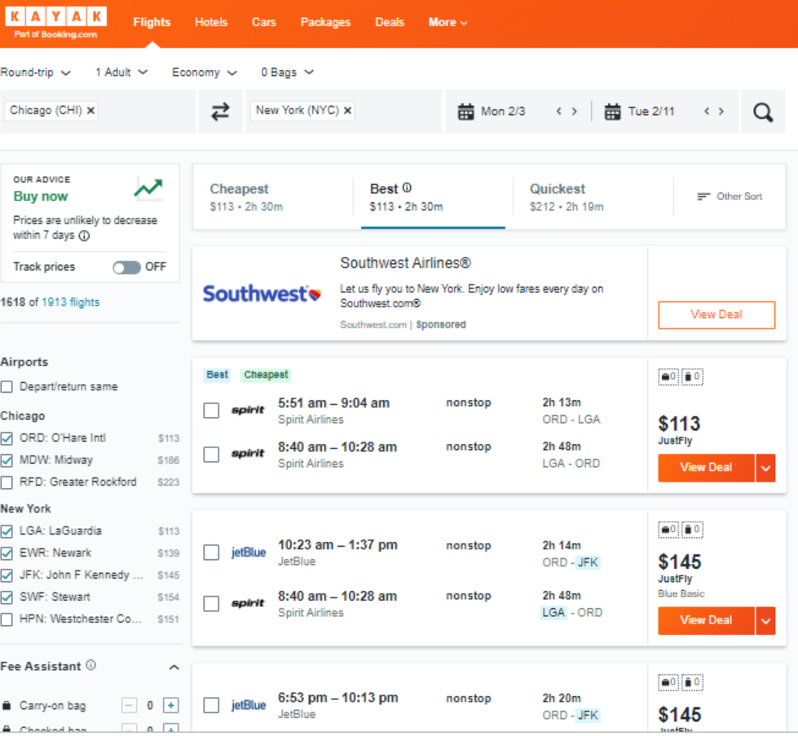


How API works?
API
API
API
Notes:
© Copyright Showeet.com – Creative & Free PowerPoint Templates

Slide 16
HTTP OVERVIEW
Notes:
© Copyright Showeet.com – Creative & Free PowerPoint Templates

Slide 17


How http works?
Verb
Headers
Content
Request
Client
Server
Notes:
© Copyright Showeet.com – Creative & Free PowerPoint Templates

Slide 18
How http works?
POST
Content Length: 9
Magic API
Request
Response
Client
Server
Status code
Headers
Content
Notes:
© Copyright Showeet.com – Creative & Free PowerPoint Templates

Slide 19
How http works?
POST
Content Length: 9
Magic API
Request
Response
Client
Server
201
Content Type: text
Magic API
Notes:
© Copyright Showeet.com – Creative & Free PowerPoint Templates

Slide 20
The Request OBJECT
verb
headers
content
HTTP Verbs / Actions
GET : Fetches/Requests Resource
POST: Creates/Inserts Resource
PUT : Updates/Modifies Resource
PATCH : Updates/Modifies Partial Resource
DELETE : Deletes/Removes Resource
More verbs…
Notes:
© Copyright Showeet.com – Creative & Free PowerPoint Templates

Slide 21
The Request OBJECT
verb
headers
content
Request’s Metadata
Content Type : Content’s Format
Content Length : Size of the Content
Authorization : Who is making the request
Accept : What are the accepted type(s)
More headers…
Notes:
© Copyright Showeet.com – Creative & Free PowerPoint Templates

Slide 22
The Request OBJECT
verb
headers
content
Request’s Content
HTML, CSS, XML, JSON
Information for the request.
Blobs etc.
Notes:
© Copyright Showeet.com – Creative & Free PowerPoint Templates

Slide 23
The RESPONSE OBJECT
Status Codes for Operation Result
100-199: Informational
200-299: Success
200 – OK
201 – Created
204 – No Content
300-399: Redirection
400-499: Client Errors
400 – Bad Request
404 – Not Found
409 – Conflict
500-599: Server Errors
500 – Internal Server Error
Status code
headers
content
Notes:
© Copyright Showeet.com – Creative & Free PowerPoint Templates

Slide 24
The RESPONSE OBJECT
Status code
headers
content
Response’s Metadata
Content Type : Content’s Format
Content Length : Size of the Content
Expires : When is this invalid
More headers…
Notes:
© Copyright Showeet.com – Creative & Free PowerPoint Templates

Slide 25
The RESPONSE OBJECT
Status code
headers
content
Content
HTML, CSS, XML, JSON
Blobs etc.
Notes:
© Copyright Showeet.com – Creative & Free PowerPoint Templates

Slide 26
Request
Response
Verb
headers
Content
Status code
headers
content
Notes:
© Copyright Showeet.com – Creative & Free PowerPoint Templates

Slide 27
What is REST?
REpresentational State Transfer
Client and Server are separate.
All Server Requests are stateless.
Cacheable Request
Issues:
REST is not perfect.
Notes:
© Copyright Showeet.com – Creative & Free PowerPoint Templates

